Slide 1


IT LEARNIX
AN ONLINE LEARNING
PLATFORM

Slide 2


TEAM MEMBERS (GB-15)
Pooja Kumari
Nishant Sarawat
Kesar Dhamija

Slide 3

Project Progress
We have included the project progress presentation along with screenshots showcasing the modules that have been completed.
These screenshots provide a visual representation of the modules that are ready for review. They serve as a comprehensive overview of the progress made in the development process, highlighting the functionality and features that have been implemented thus far..

Slide 4





COMPLETED MODULES
Registration
Home
Courses
Contact
Mentors
Blogs

Slide 5
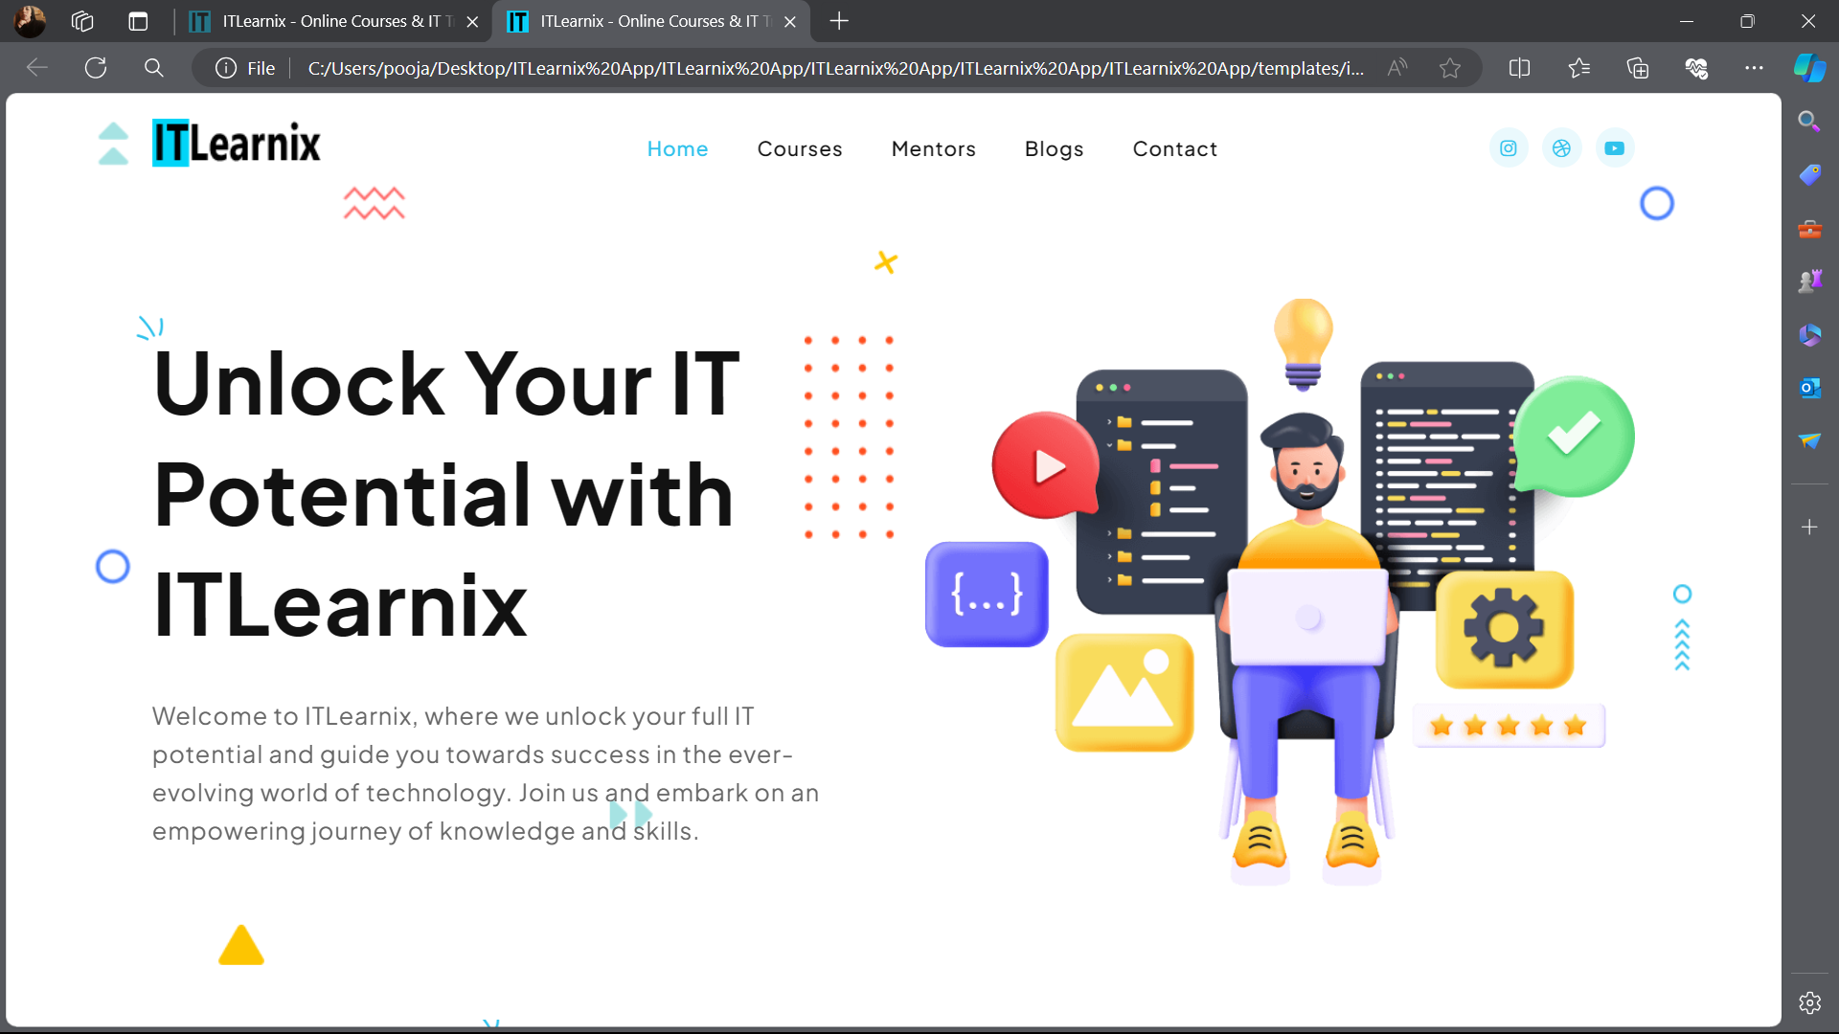
HOME

Slide 6
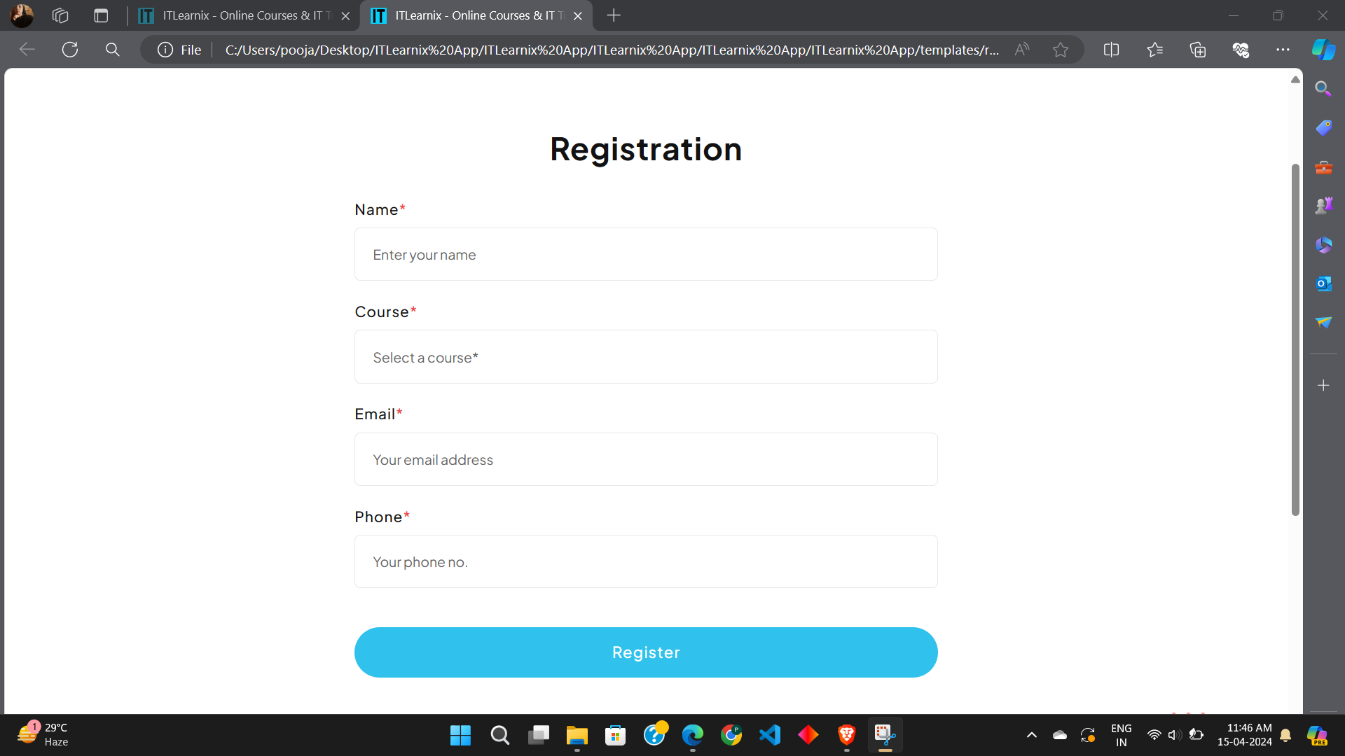
REGISTRATION

Slide 7
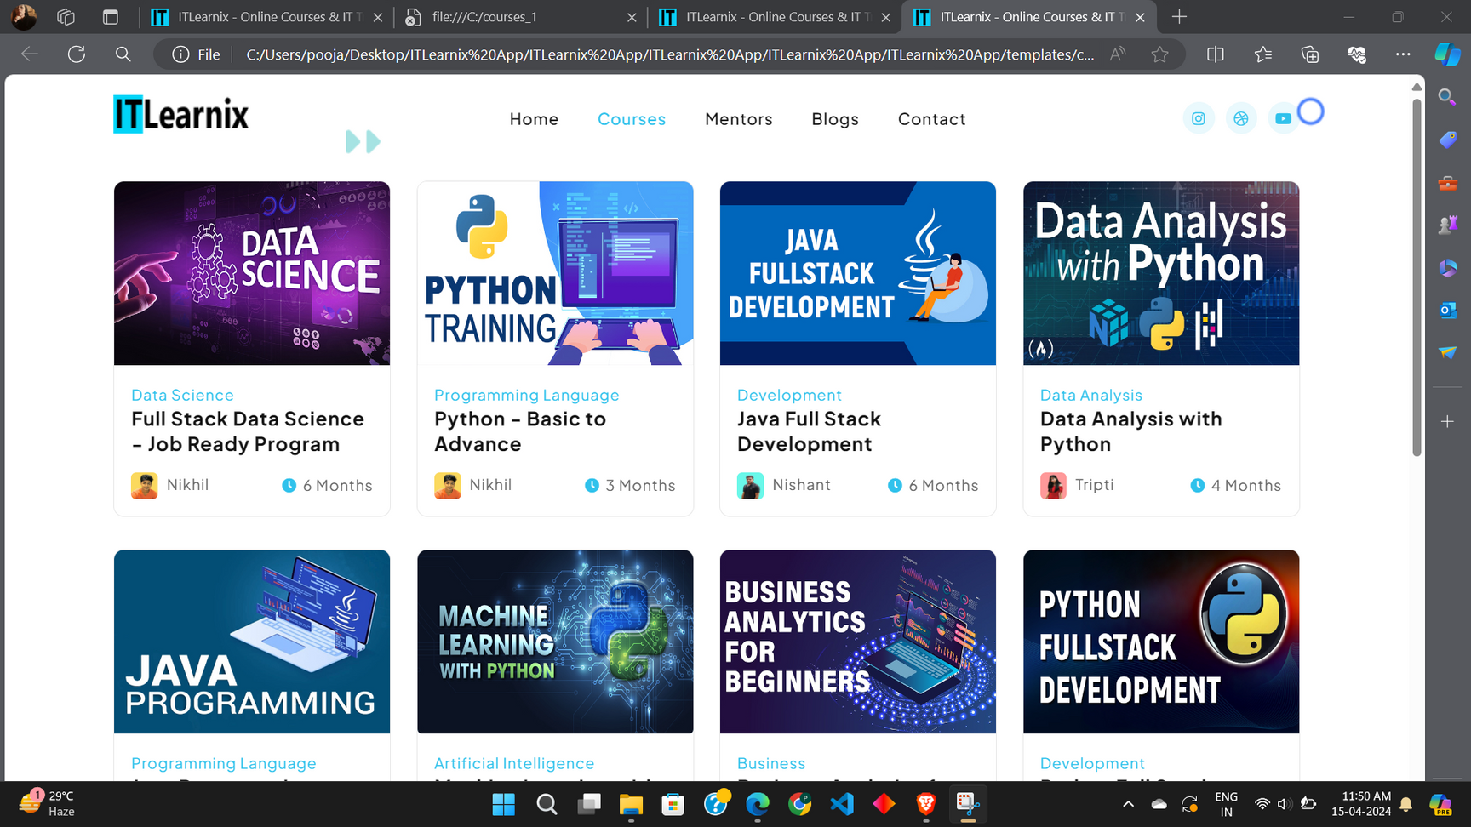
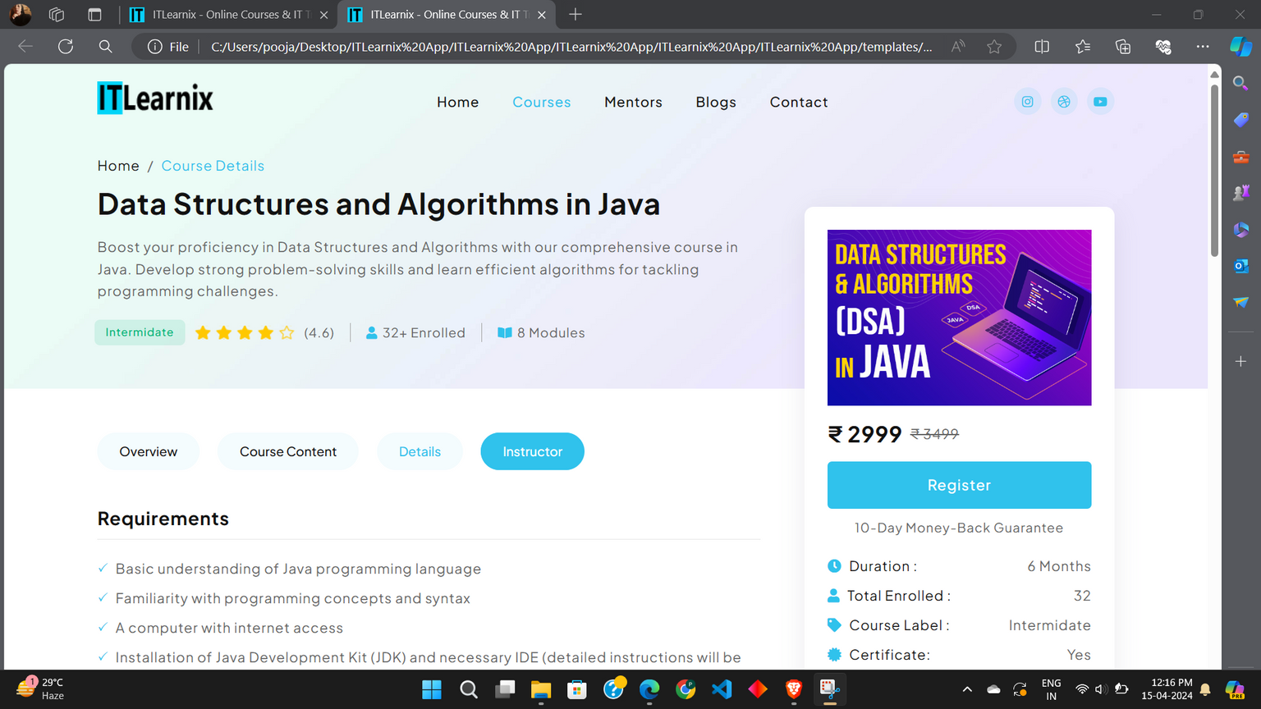
COURSE

Slide 8
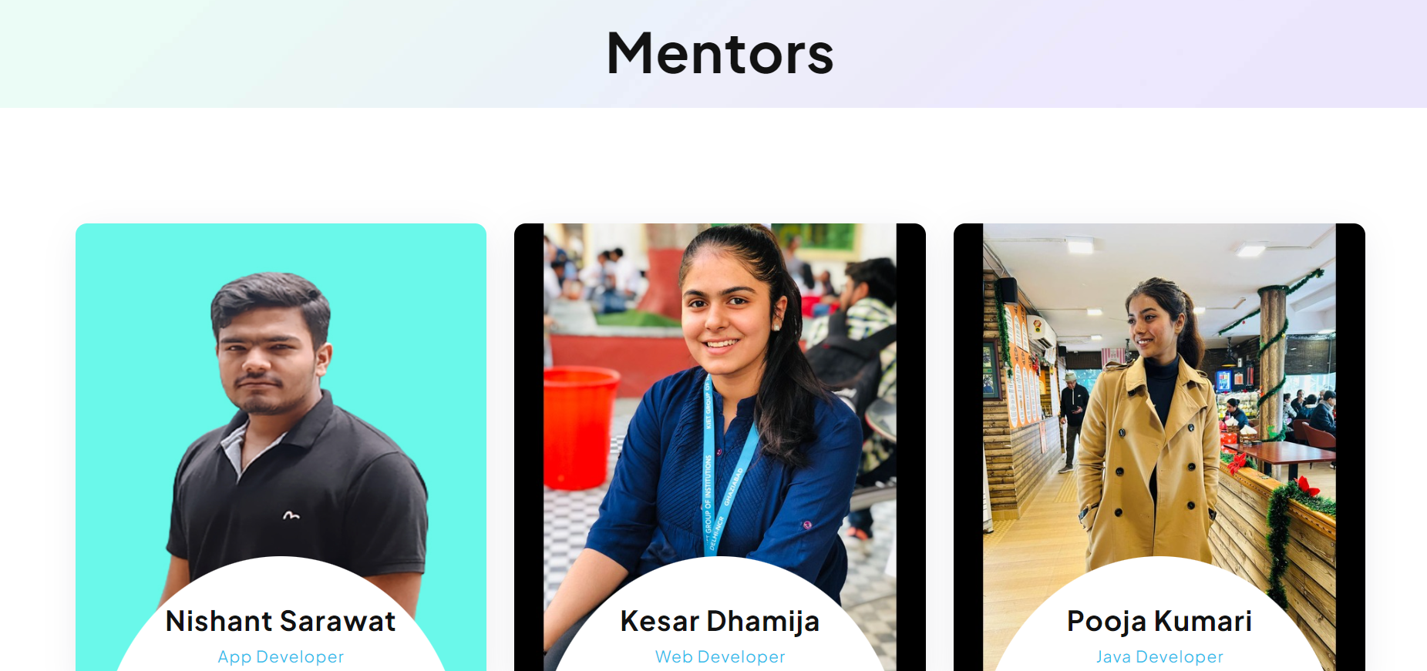
MENTOR

Slide 9
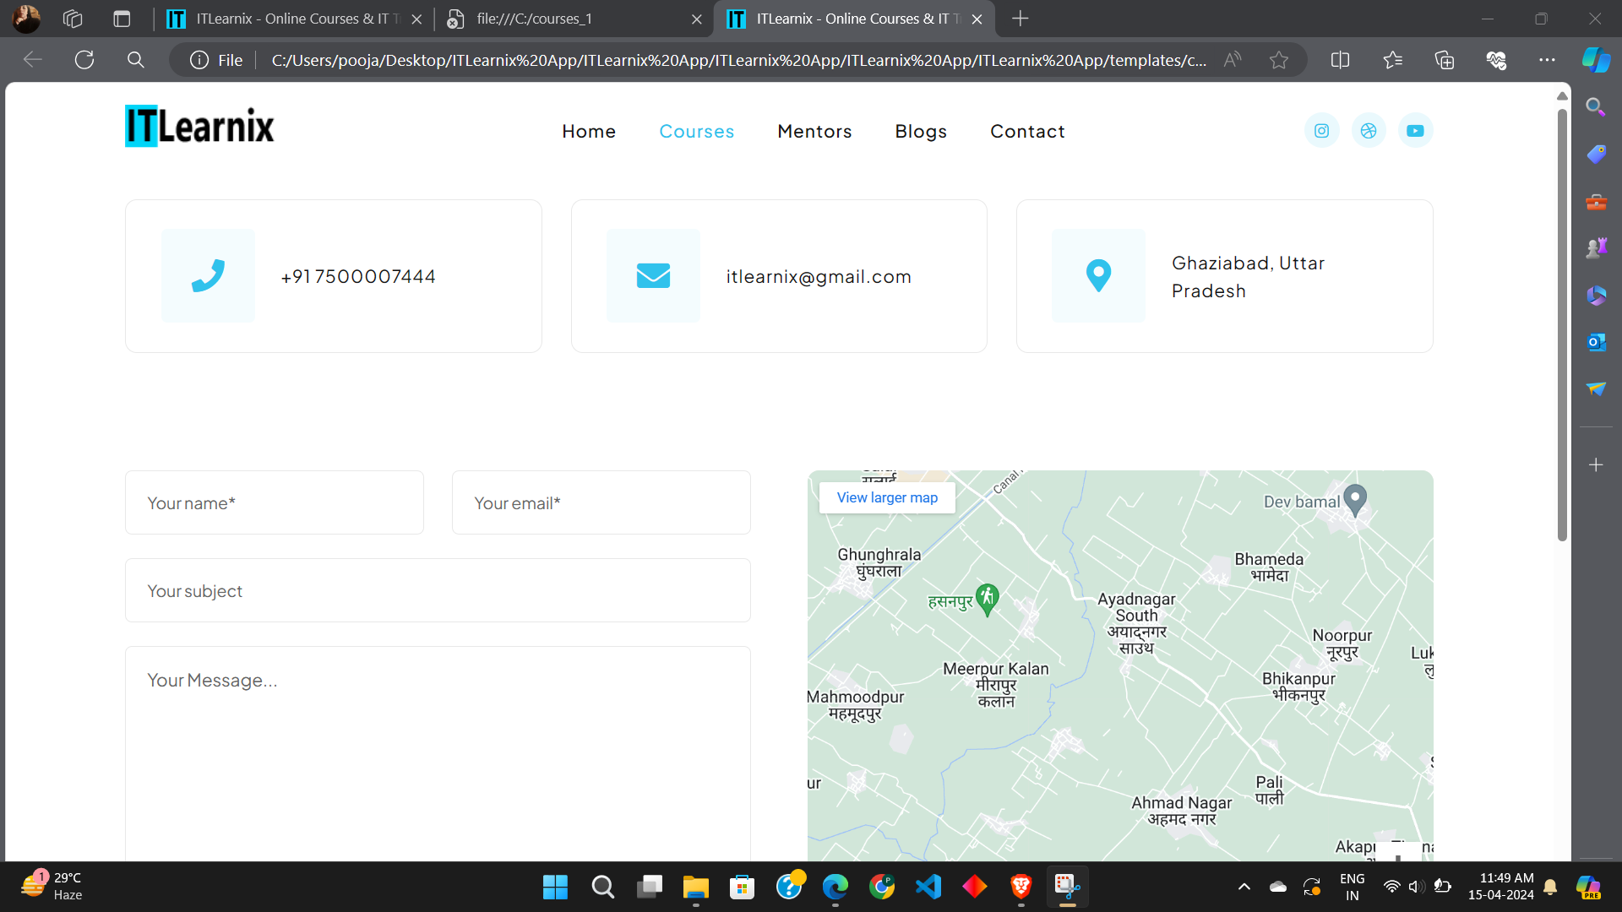
CONTACT

Slide 10
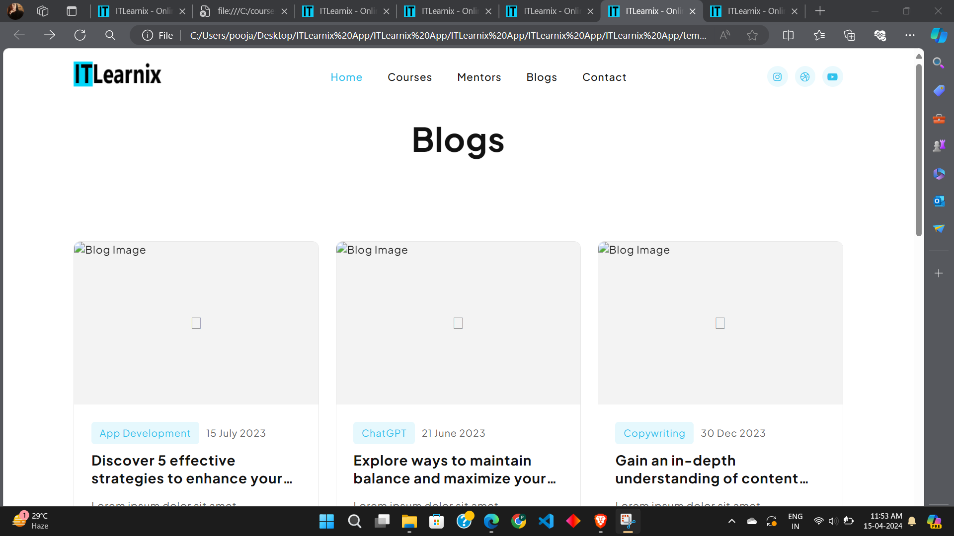
BLOG

Slide 11

THANK YOU

